Slide 1




Electron Ion Colliders
Vladimir N. Litvinenko
Brookhaven National Laboratory, Upton, NY, USA
Stony Brook University, Stony Brook, NY, USA
Center for Accelerator Science and Education
V.N. Litvinenko, EINN 2009, Milos, Greece, September 27, 2009

Slide 2
Preamble: Electron Ion Collider
BNL & MIT
TJNAF
Add 10 GeV electron machine to RHIC with 250 GeV polarized protons and 100 GeV/n ions
Luminosity is based on hadron beam parameters demonstrated in RHIC complex
First paper and workshop on eRHIC – 1999
“eRHIC Zeroth-Order Design Report” and cost estimate, BNL 2004
  Ring-ring (e-ring designed by MIT) was the main option, L~10³²
  70+ page appendix on Linac (ERL) – Ring as back-up, L~10³³
2007 – after detailed studies we found that linac-ring has 5-10 fold higher luminosity – it became the main option
eA group made a case that 20 (or even 30 GeV) electrons are needed
March 2008 – first staging option of eRHIC of all-in-the tunnel ERL with 2(4) GeV as the first stage, with 10 GeV and 20 GeV as next steps
  there is potential for increase of RHIC energy to 800 GeV if physics justifies the cost
2009 – we plan to release first release of Design Report on MeRHIC (Medium energy eRHIC)
Started later than eRHIC and aimed from the beginning at L~10³⁵
ELIC - Electron-Light-Ion Collider – new electron and hadron accelerators taking advantage of CEBAF as injector
Energy range and species evolved from 7 x 65 GeV to 10 x 250 GeV following eRHIC trend
Present energy range (as Feb.2009) :
  protons 150 GeV, electrons 7 GeV
  protons 250 GeV, 10 GeV electron
ELIC started from Linac-Ring version and finished with Ring-Ring
“ELIC Zeroth-Order Design Report”, TJNAF, 2008
December 2008, Staging option for ELIC
February 2009, first price estimate was presented
V.N. Litvinenko, EINN 2009, Milos, Greece, September 27, 2009

Slide 3
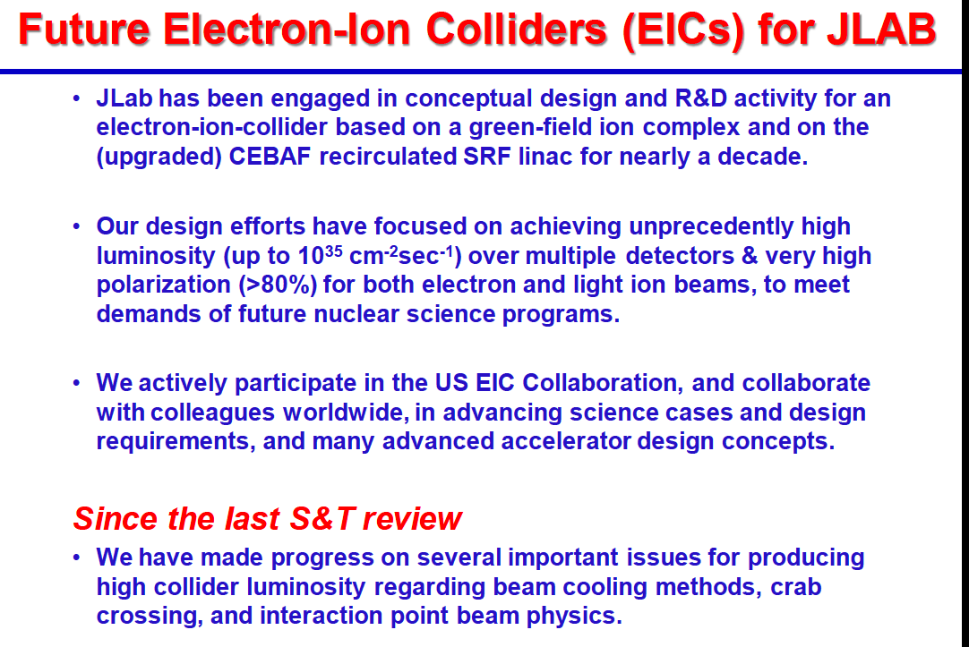
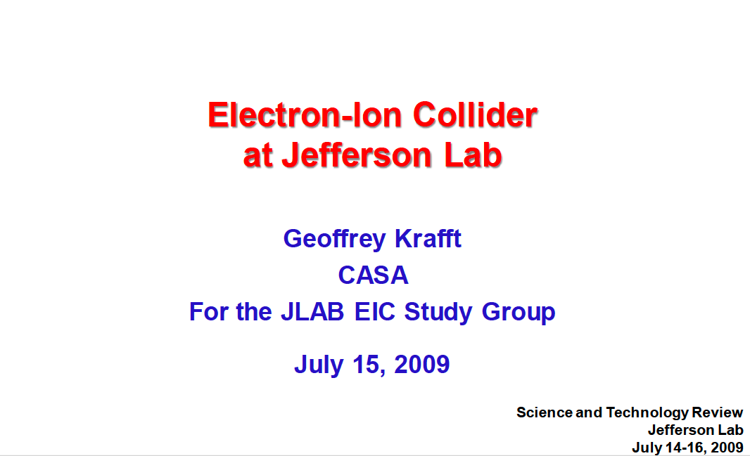
ELIC – EIC at TJNAF
A. Afanasev, A. Bogacz, P. Brindza, A. Bruell, L. Cardman, Y. Chao, S. Chattopadhyay, E. Chudakov, P. Degtiarenko, J. Delayen, Ya. Derbenev, R. Ent, P. Evtushenko, A. Freyberger, D. Gaskell, J. Grames, L. Harwood, A. Hutton, C. Hyde, T. Horn, R. Kazimi, G. A. Krafft, F. Klein, R. Li, L. Merminga, J. Musson, P. Nadel-Turonski, M. Poelker, R. Rimmer, Chaivat Tengsirivattana, A. Thomas, H. Wang, C. Weiss, B. Wojtsekhowski, B. Yunn, Y. Zhang - Jefferson Laboratory Staff and Users
W. Fischer, C. Montag - Brookhaven National Laboratory
V. Danilov - Oak Ridge National Laboratory
V. Dudnikov - Brookhaven Technology Group
P. Ostroumov - Argonne National Laboratory
V. Derenchuk - Indiana University Cyclotron Facility
A. Belov - Institute of Nuclear Research, Moscow, Russia
V. Shemelin - Cornell University
Courtesy of G. Krafft

Slide 4
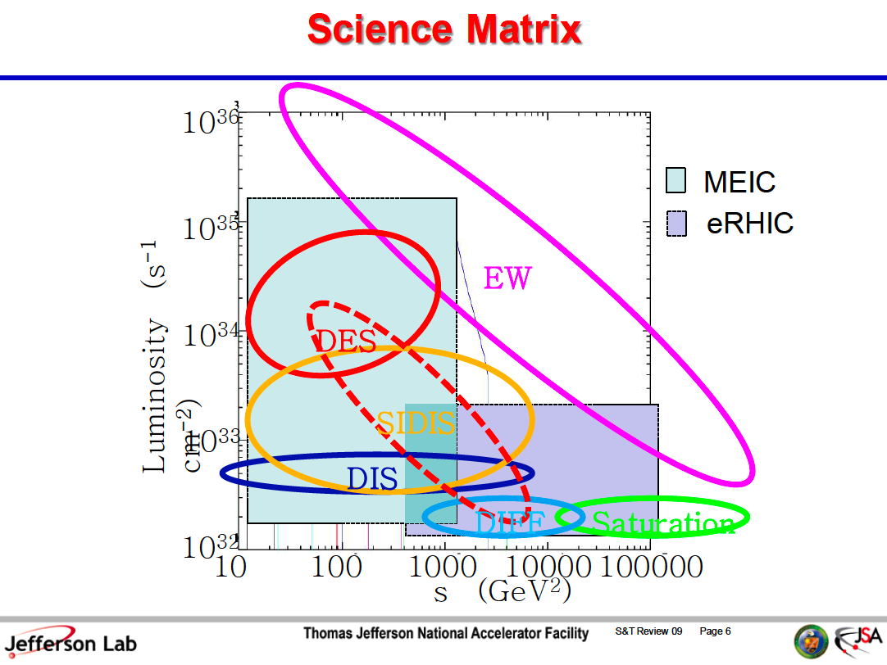
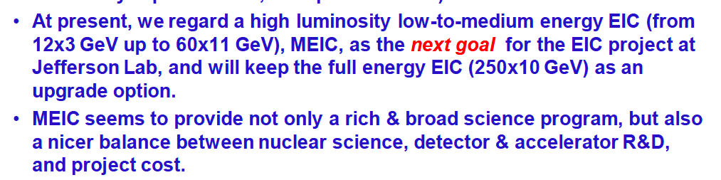
ELIC’s veiw
eRHIC II
Courtesy of G. Krafft
Luminosity reach
for eRHIC corrected
by V. N. Litvinenko
to fit Jlab assumptions
on achievable beam optics
(see follow up slides)
eRHIC
MeRHIC
Courtesy of G. Krafft

Slide 5
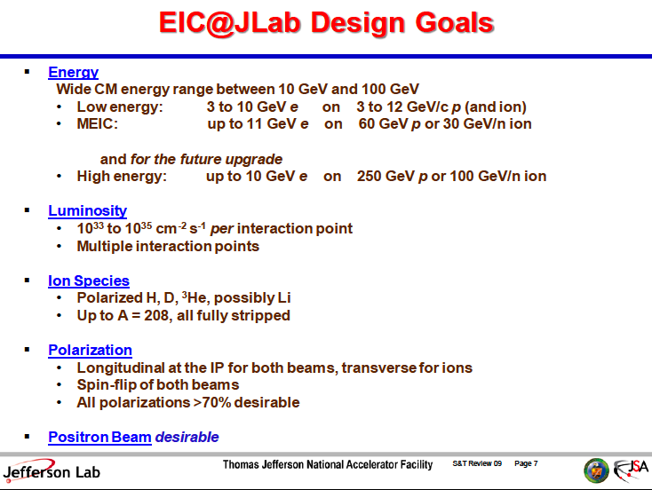
Courtesy of G. Krafft

Slide 6
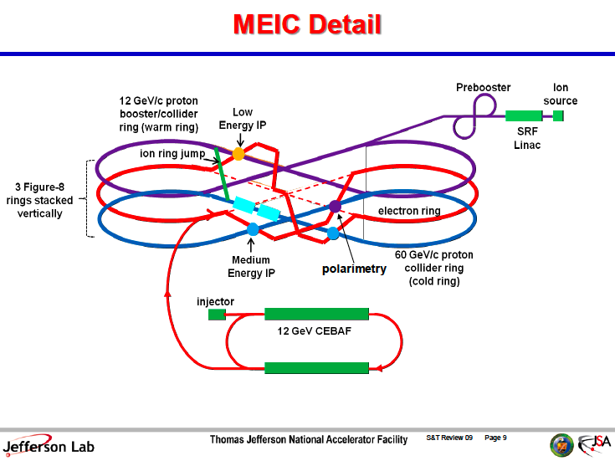
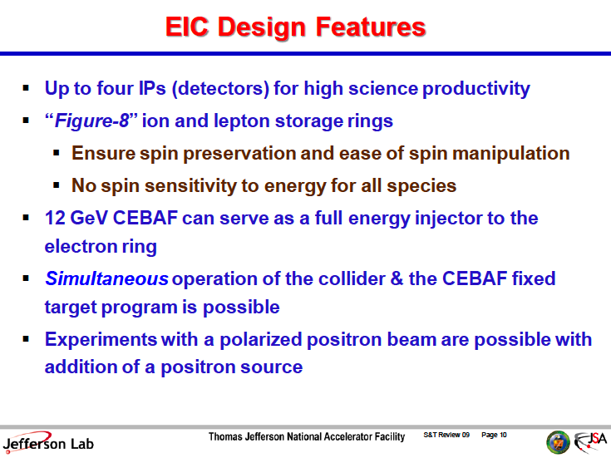
Courtesy of G. Krafft

Slide 7
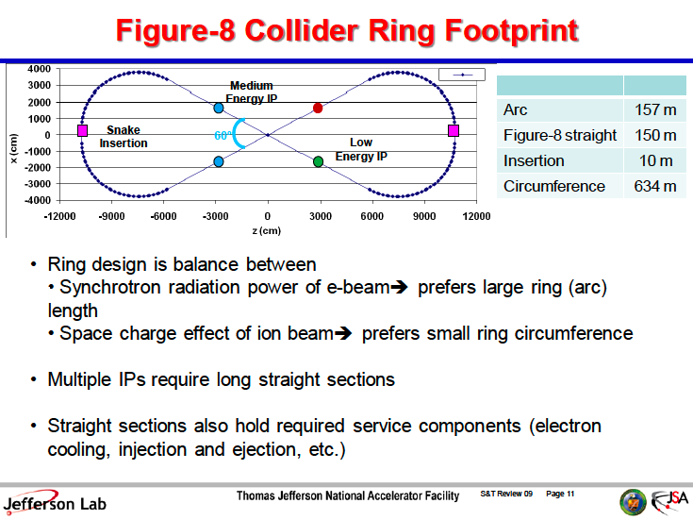
Courtesy of G. Krafft

Slide 8
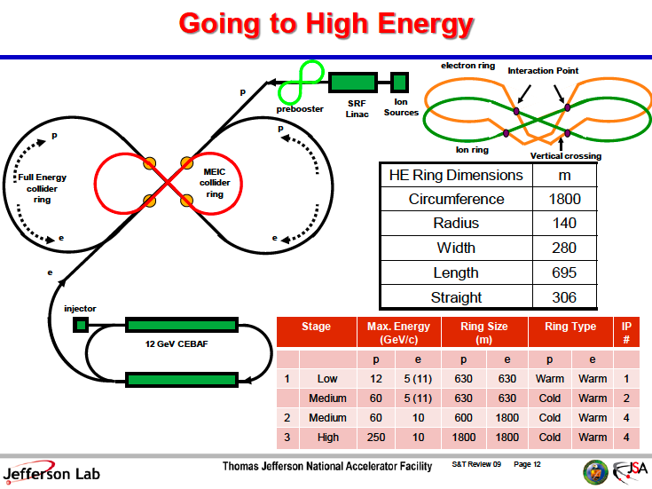
Courtesy of G. Krafft

Slide 9
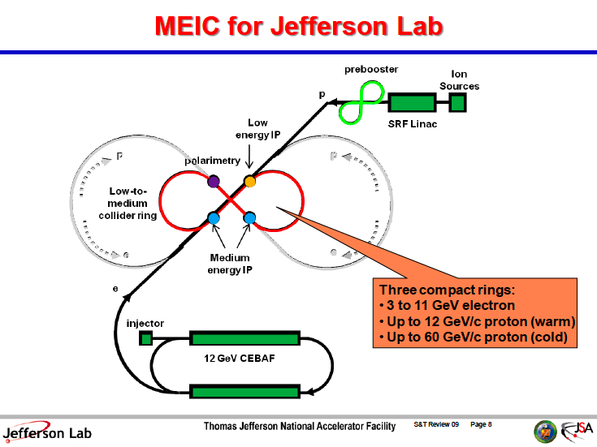
Courtesy of G. Krafft

Slide 10
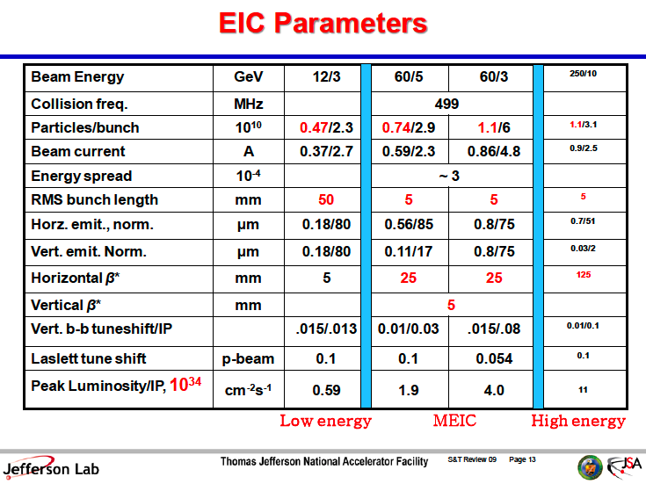
Courtesy of G. Krafft

Slide 11
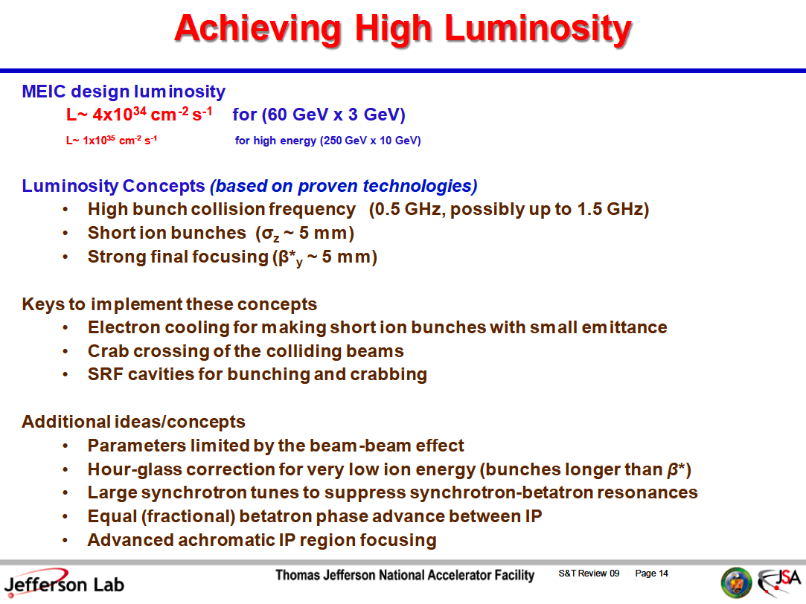
Courtesy of G. Krafft

Slide 12
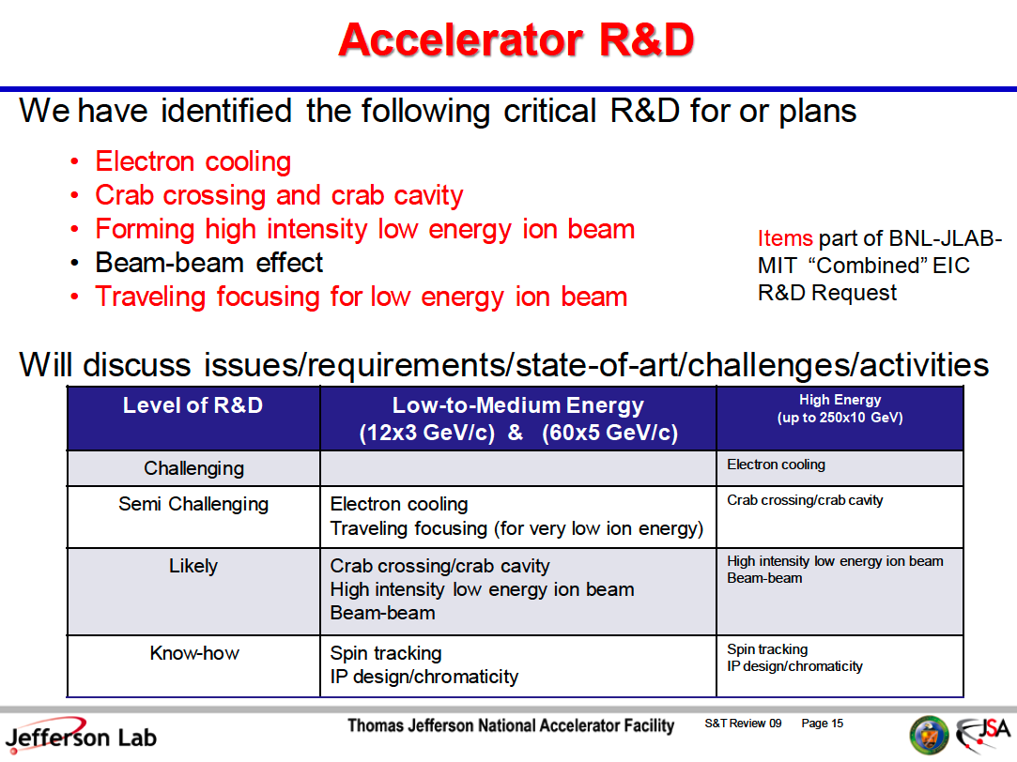
Courtesy of G. Krafft

Slide 13
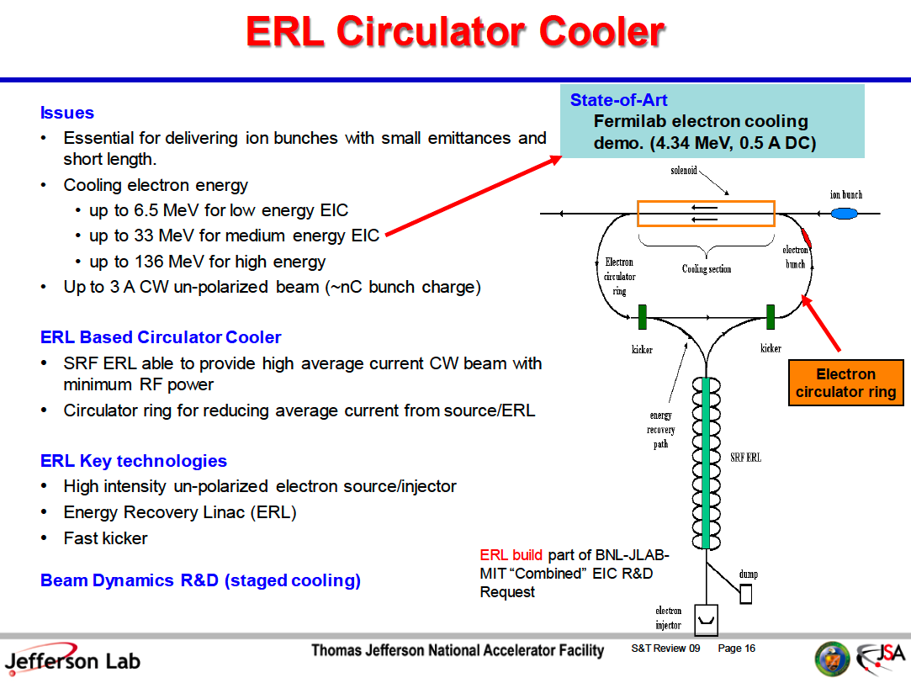
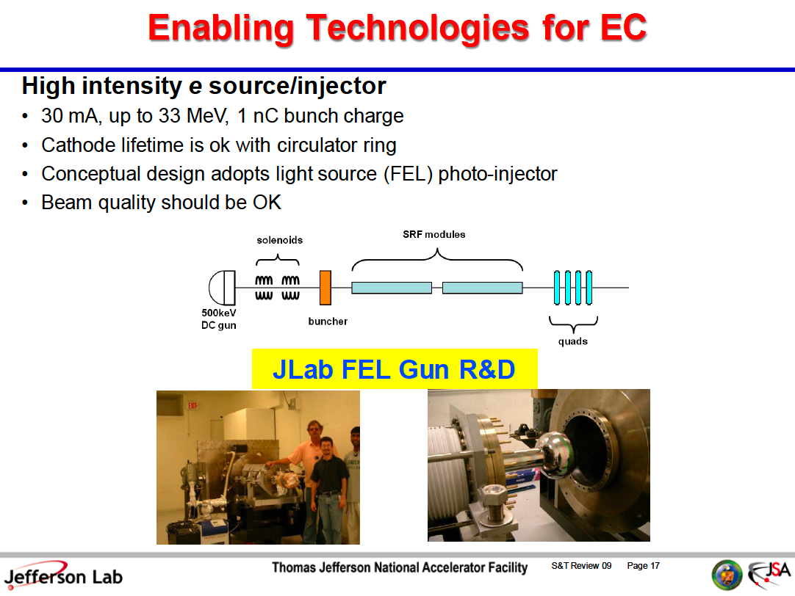
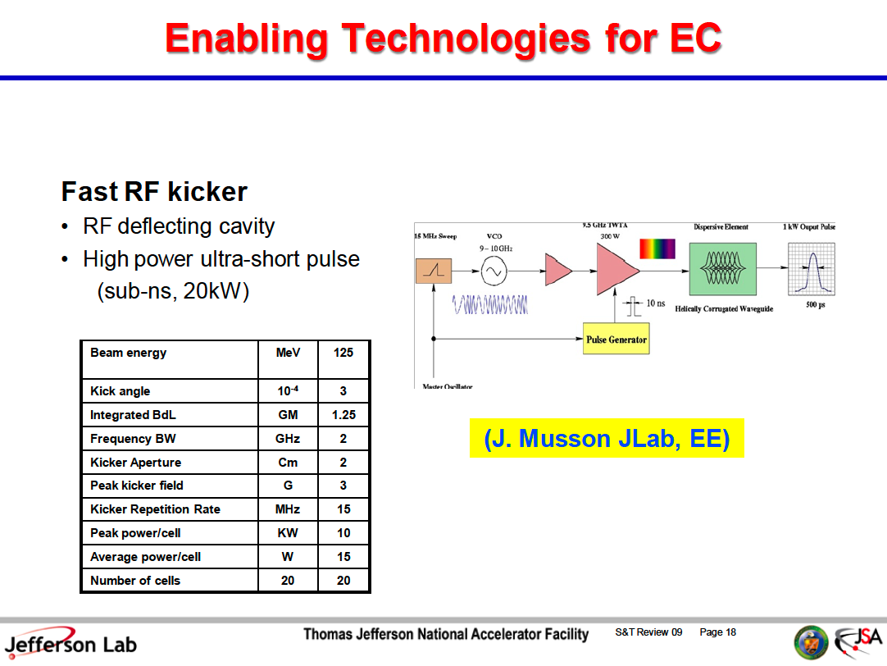
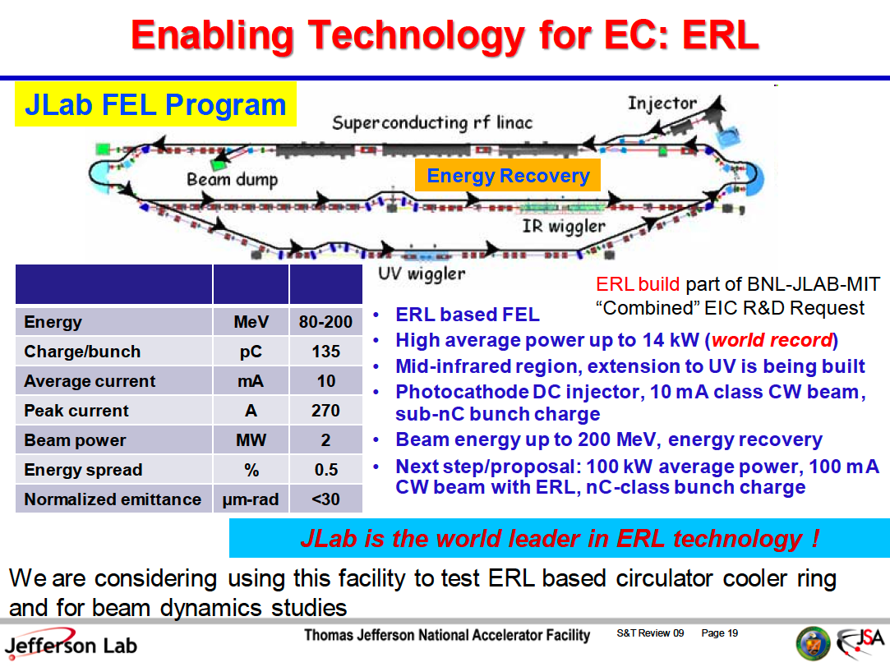
Courtesy of G. Krafft

Slide 14
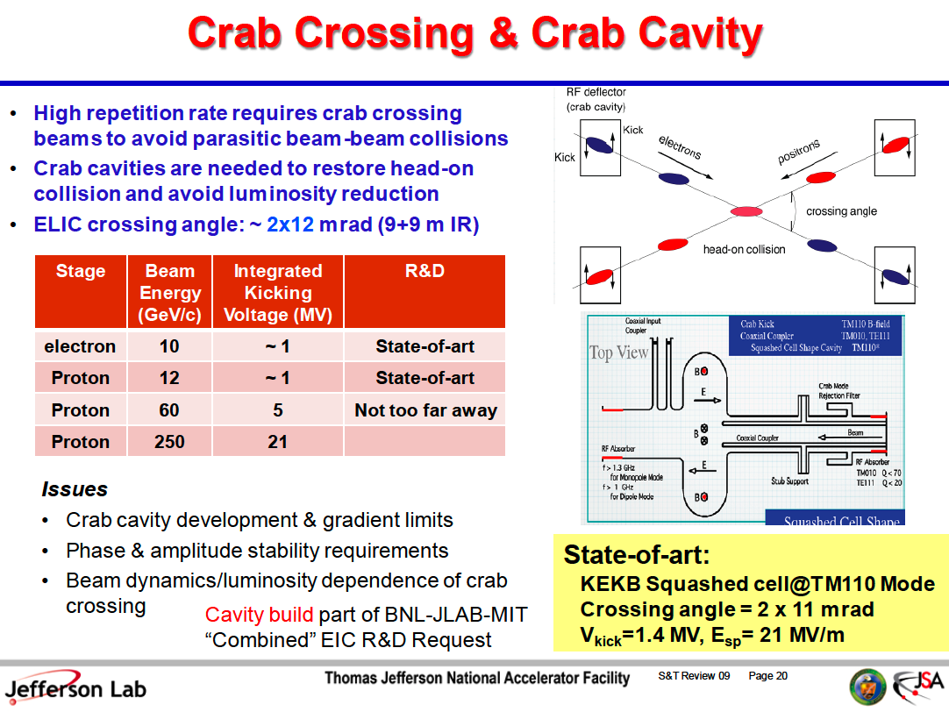
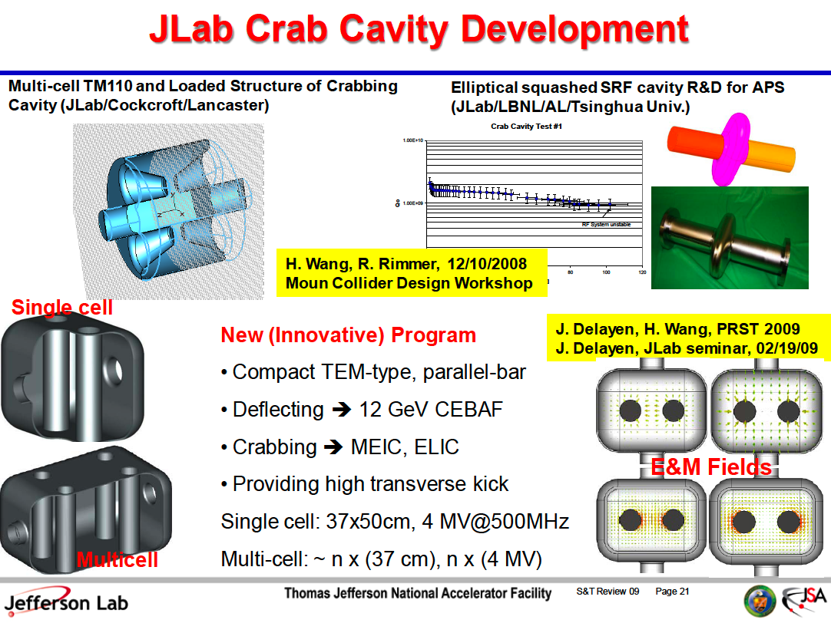
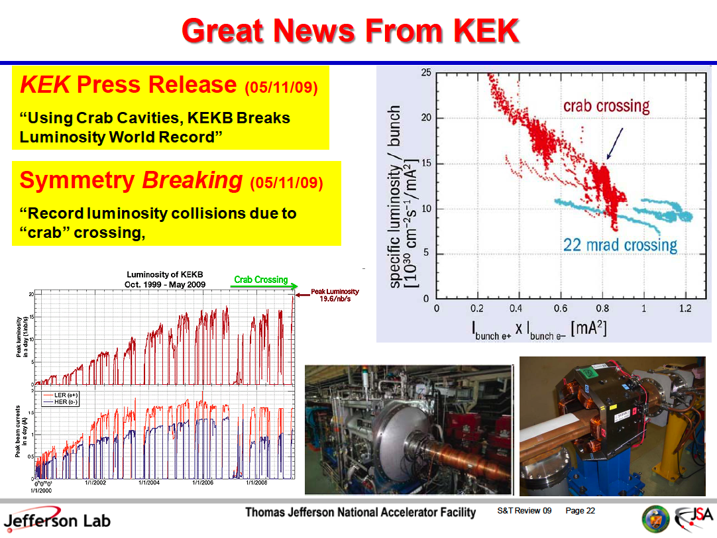
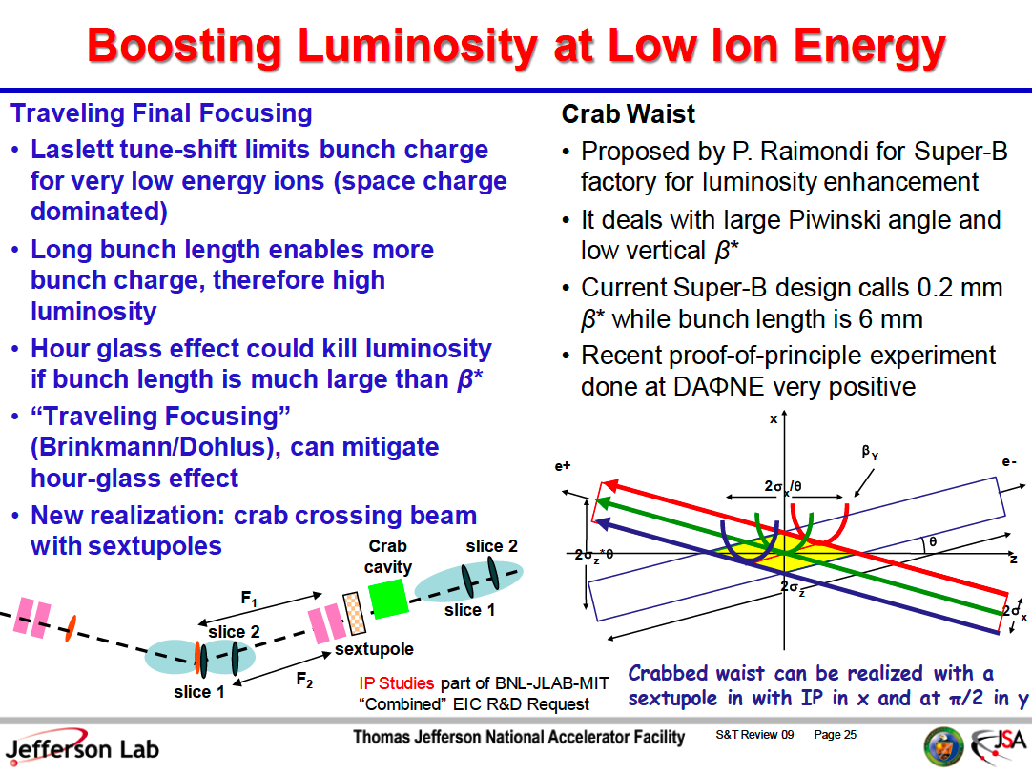
Courtesy of G. Krafft

Slide 15
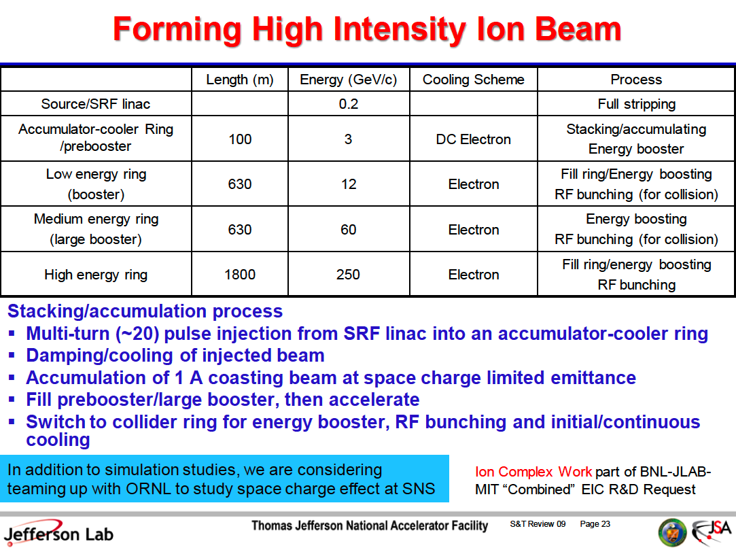
Courtesy of G. Krafft

Slide 16
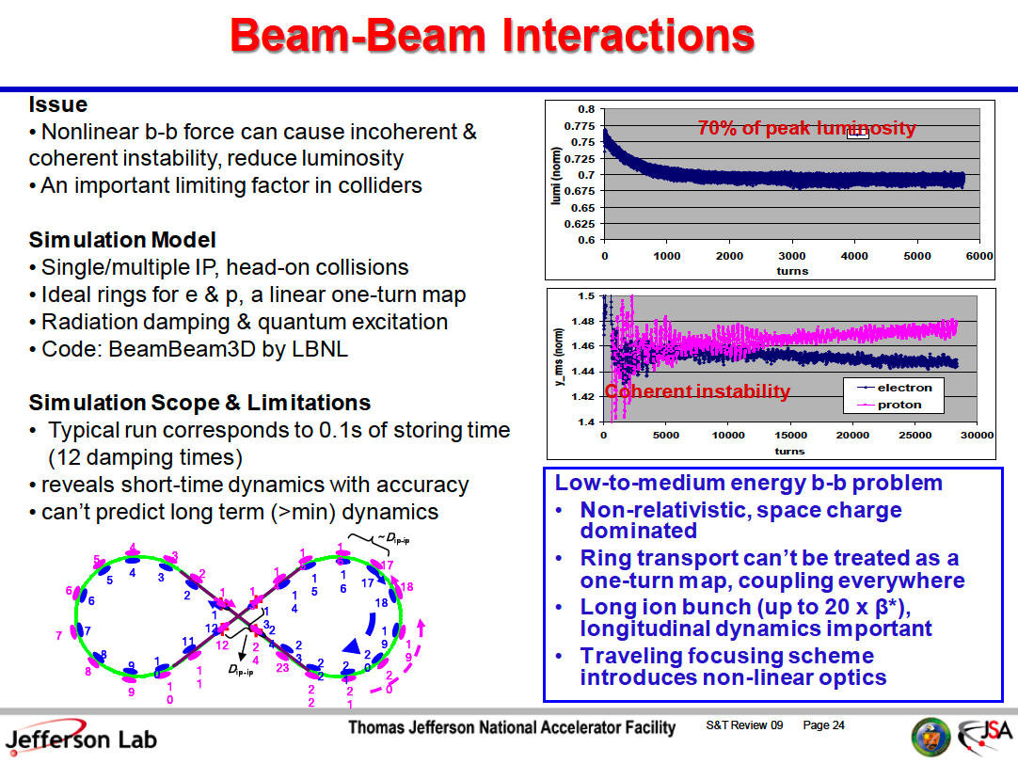
Courtesy of G. Krafft

Slide 17
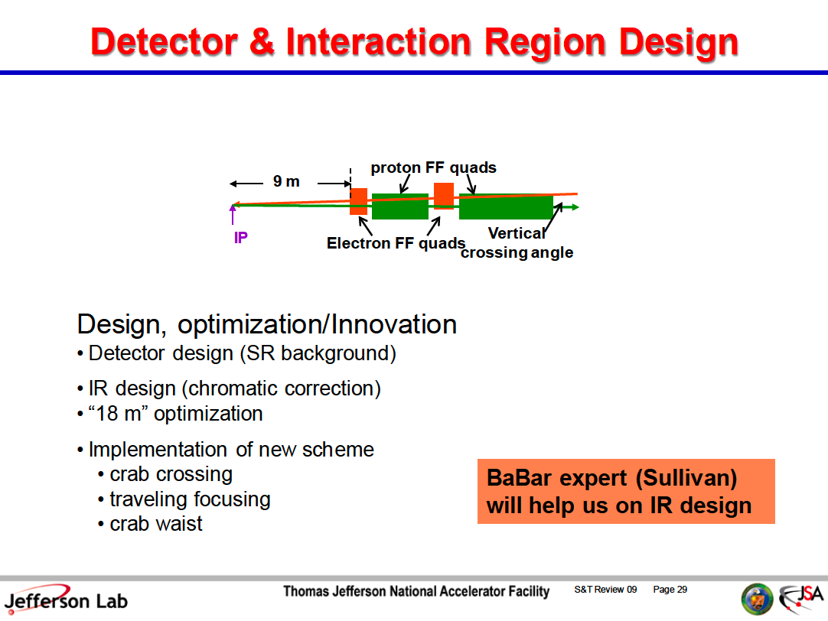
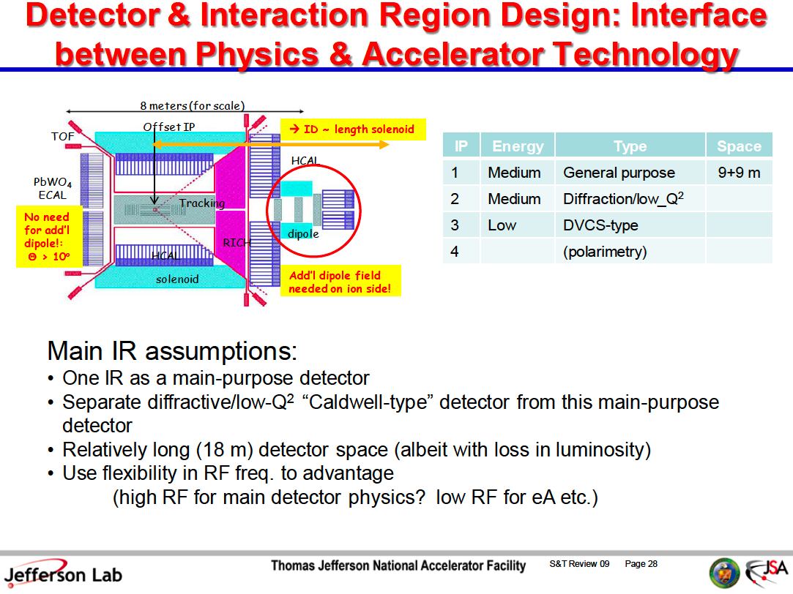
Courtesy of G. Krafft

Slide 18
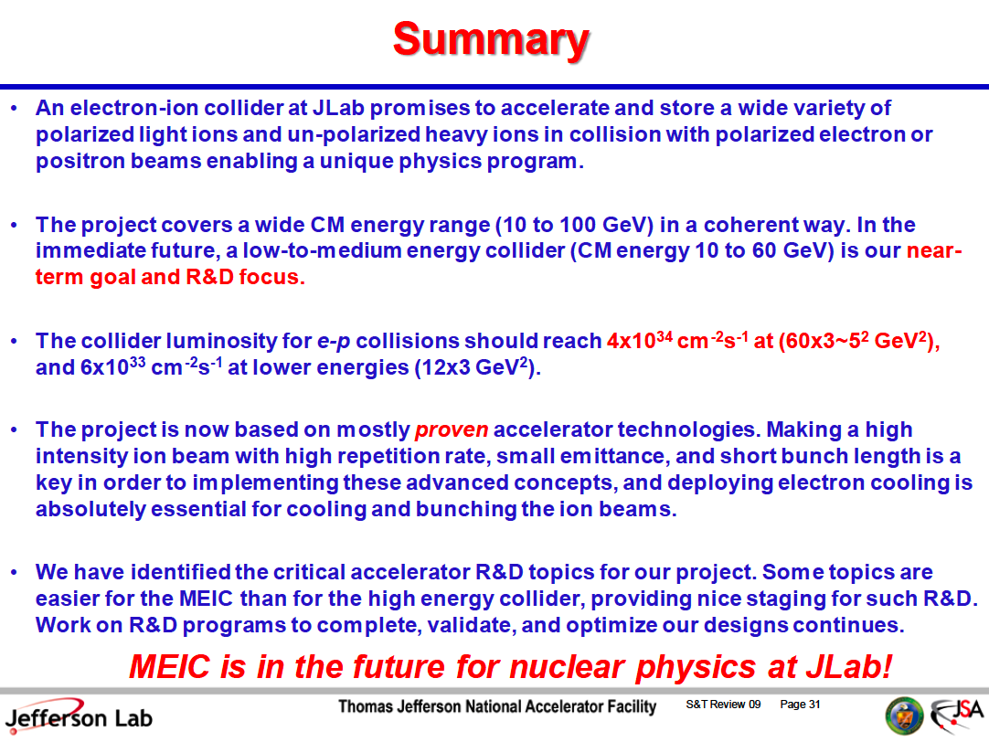
Courtesy of G. Krafft

Slide 19
eRHIC
EIC at BNL
Vladimir N. Litvinenko
Brookhaven National Laboratory, Upton, NY, USA
Stony Brook University, Stony Brook, NY, USA
Center for Accelerator Science and Education
V.N. Litvinenko, EINN 2009, Milos, Greece, September 27, 2009

Slide 20
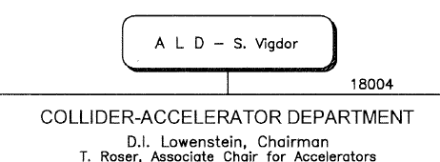
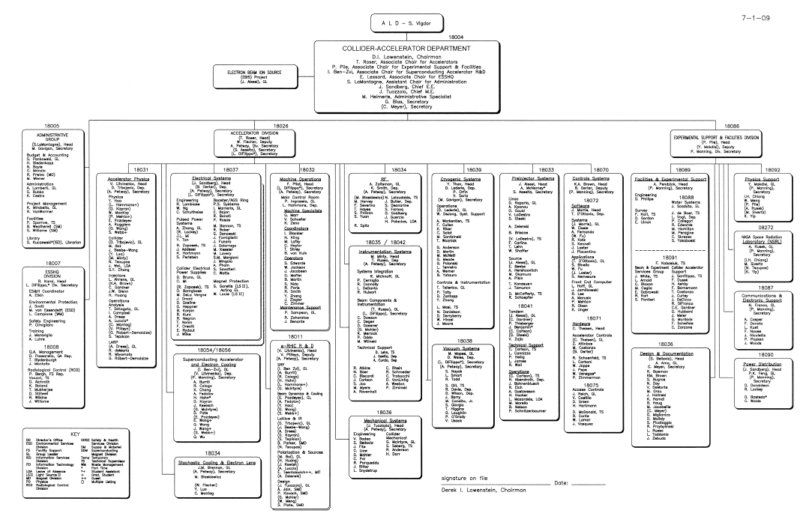
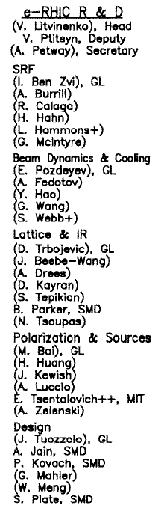
Materials are from eRHIC R&D group and EIC task force
www.bnl.gov/cad/eRhic/
Inputs on Physics from BNL EIC task force lead by E.-C. Aschenauer, T. Ulrich http://www.eic.bnl.gov/taskforce.html,
A.Cadwell, A.Deshpande, R. Ent, T. Horn, H. Kowalsky, M. Lamont, T.W. Ludlam,
R. Milner, B. Surrow, S.Vigdor, R. Venugopalan, W.Vogelsang, ….
V.N. Litvinenko, EINN 2009, Milos, Greece, September 27, 2009

Slide 21

2007 Choosing the focus:
ERL or ring for electrons?
Two main design options for eRHIC:
  Ring-ring:
  Linac-ring:
Electron storage ring
RHIC
✔
Electron linear accelerator
RHIC
L x 10
V.N. Litvinenko, EINN 2009, Milos, Greece, September 27, 2009

Slide 22
Content
What is eRHIC
eRHIC staging
MeRHIC design
IP developments and ideas
eRHIC R&D
Outlook
V.N. Litvinenko, EINN 2009, Milos, Greece, September 27, 2009

Slide 23
eRHIC Scope -QCD Factory
RHIC
Electron accelerator
p
Polarized protons
₂₅↓ 50-250 (325) GeV
Unpolarized and
polarized leptons
4-20 (30) GeV
e⁻
e⁻
Light ions (d,Si,Cu)
Heavy ions (Au,U)
50-100 (130) GeV/u
e⁺
70% beam polarization goal
Positrons at low intensities
Polarized light ions (He³) 215 GeV/u
Center mass energy range: 15-200 GeV
eA program for eRHIC needs as high as possible energies of electron beams even with a trade-off for the luminosity: 20 GeV is absolutely essential and 30 GeV is strongly desirable
V.N. Litvinenko, EINN 2009, Milos, Greece, September 27, 2009

Slide 24
Progress with eRHIC
Continued:
  Development of R&D ERL
  Small gap magnets
  Understanding and suppression of kink instability
  Simulation of electron beam disruption in the collision
  Simulations of the beam-beam effects on hadron beam
New developments
  MeRHIC lattice and cost estimating
  eRHIC staging and cost estimate
  Coherent electron cooling for RHIC pp and eRHIC
  Compact spreaders and combiner
  Effects of wake-fields on beam energy loss and beam quality
  Synchrotron radiation effects
Publications on eRHIC-related accelerator R&D
  About 25 papers in last year including one Phys. Rev . Lett.
V.N. Litvinenko, EINN 2009, Milos, Greece, September 27, 2009

Slide 25
2008: Staging of eRHIC
MeRHIC: Medium Energy eRHIC
  Both Accelerator and Detector are located at IP2 of RHIC
  4 GeV e⁻ x 250 GeV p (45 or 63 GeV c.m.), L ~ 10³²-10³³ cm⁻² sec ⁻¹
  90% of hardware will be used for HE eRHIC
eRHIC, High energy and luminosity phase, inside RHIC tunnel
Full energy, nominal luminosity
  Polarized 20 GeV e⁻ x 325 GeV p (160 GeV c.m), L ~ 10³³-10³⁴ cm⁻² sec ⁻¹
  30 GeV e x 120 GeV/n Au (120 GeV c.m.), ~1/5 of full luminosity
  and 20 GeV e x 120 GeV/n Au (120 GeV c.m.), full liminosity
eRHIC up-grades – if needed
V.N. Litvinenko, EINN 2009, Milos, Greece, September 27, 2009

Slide 26

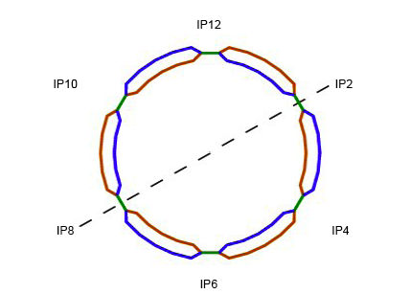


4 GeV e x 250 GeV p – 100 GeV/u Au
MeRHIC
2 x 60 m SRF linac
3 passes, 1.3 GeV/pass
Polarized
e-gun
Beam
dump
MeRHIC
detector
3 pass 4 GeV ERL
PHENIX
STAR
V.N. Litvinenko, EINN 2009, Milos, Greece, September 27, 2009

Slide 27
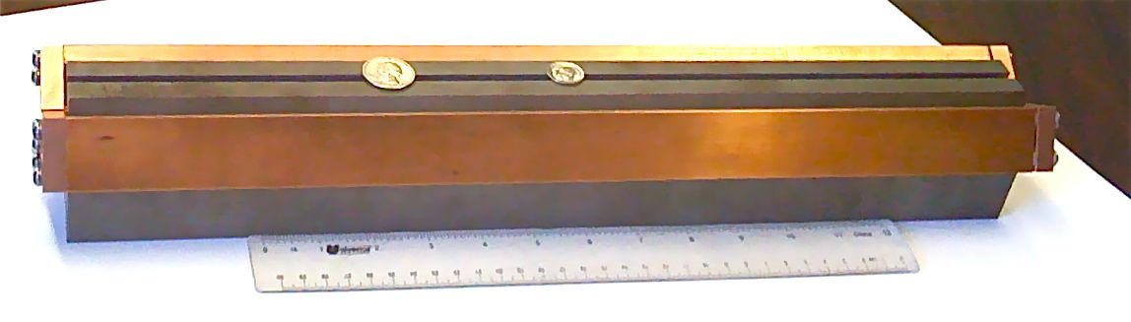

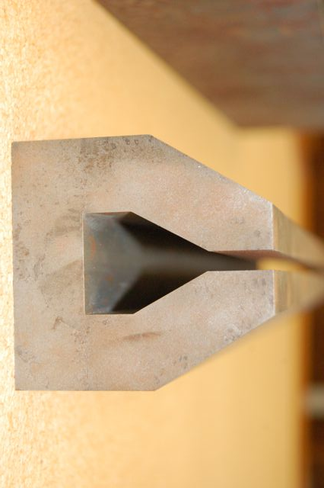
10 to 20 GeV e x 325 GeV p – 130 GeV/u Au
eRHIC
2 x 200 m SRF linac
4 (5) GeV per pass
5 (4) passes
Gap 5 mm total
0.3 T for 30 GeV
eRHIC
detector
Polarized
e-gun
Beam
dump
Coherent
e-cooler
MeRHIC
detector
20 GeV
e-beam
5 mm
16 GeV
e-beam
Common vacuum chamber
5 mm
Possibility of 30 GeV low current
operation
12 GeV
e-beam
PHENIX
8 GeV
e-beam
5 mm
5 mm
4 to 5 vertically separated
recirculating passes
STAR
V.N. Litvinenko, EINN 2009, Milos, Greece, September 27, 2009

Slide 28
30 GeV e x 800 GeV p – 320 GeV/u U
eRHIC II
3 x 200 m SRF linac
6 GeV per pass
5 passes
Up-grade:
New LHC-class SC magnets
in Blue ring
Polarized
e-gun
Beam
dump
Coherent
e-cooler
20 GeV
e-beam
5 mm
16 GeV
e-beam
Common vacuum chamber
5 mm
12 GeV
e-beam
(e)PHENIX
8 GeV
e-beam
5 mm
Yellow ring serves as
200 GeV injector into upgraded
Blue ring
5 mm
4 to 5 vertically separated
recirculating passes
(e)STAR
V.N. Litvinenko, EINN 2009, Milos, Greece, September 27, 2009

Slide 29
eRHIC
Price will be in the precision
not in the size
V.N. Litvinenko, EINN 2009, Milos, Greece, September 27, 2009

Slide 30
Staging of eRHIC:
Re-use, Beams and Energetics
MeRHIC: Medium Energy electron-Ion Collider
  90% of ERL hardware will be use for full energy eRHIC
  Possible use of the detector in eRHIC operation
eRHIC – High energy and luminosity phase
  Based on present RHIC beam intensities
  With coherent electron cooling requirements on the electron beam current is 50 mA
  20 GeV, 50 mA electron beam losses 4 MW total for synchrotron radiation.
  30 GeV, 10 mA electron beam loses 4 MW for synchrotron radiation
  Power density is <2 kW/meter and is well within B-factory limits (8 kW/m)
eRHIC upgrade(s) if needed
V.N. Litvinenko, EINN 2009, Milos, Greece, September 27, 2009

Slide 31
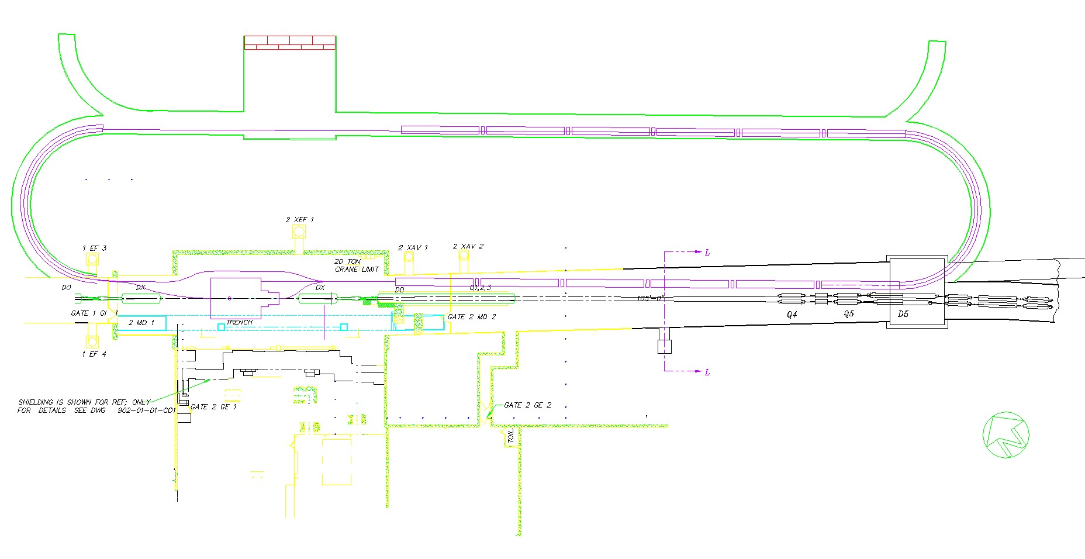
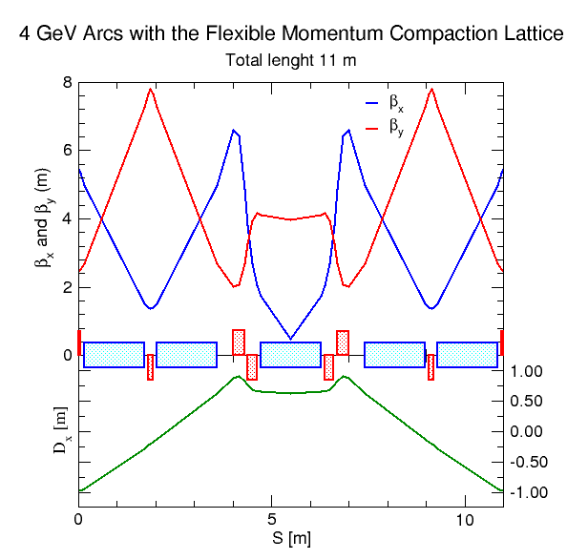
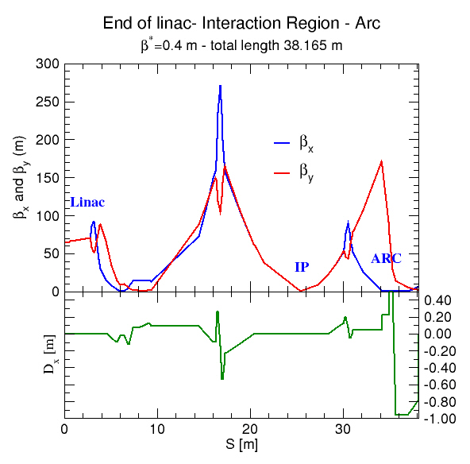
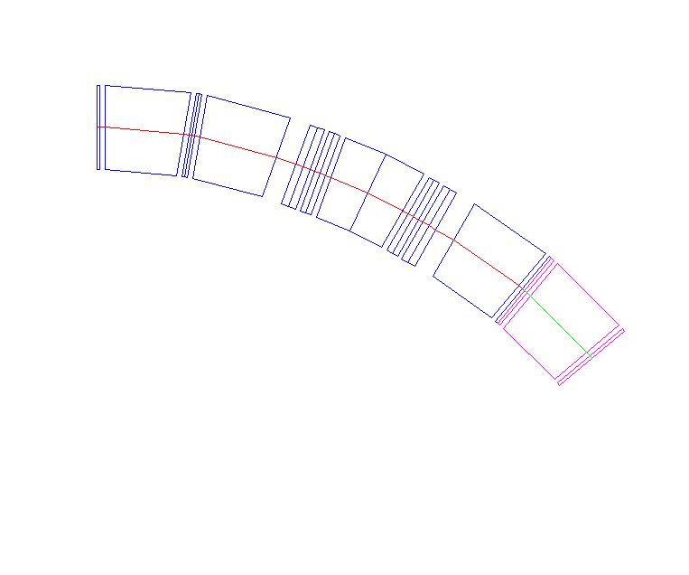
MeRHIC with 4 GeV ERL at 2 o’clock IR of RHIC
Linac 1
Linac 1
Lattice and IR by D.Trbojevic, D.Kayran
Linac 2
(April 09)
V.N. Litvinenko, EINN 2009, Milos, Greece, September 27, 2009

Slide 32
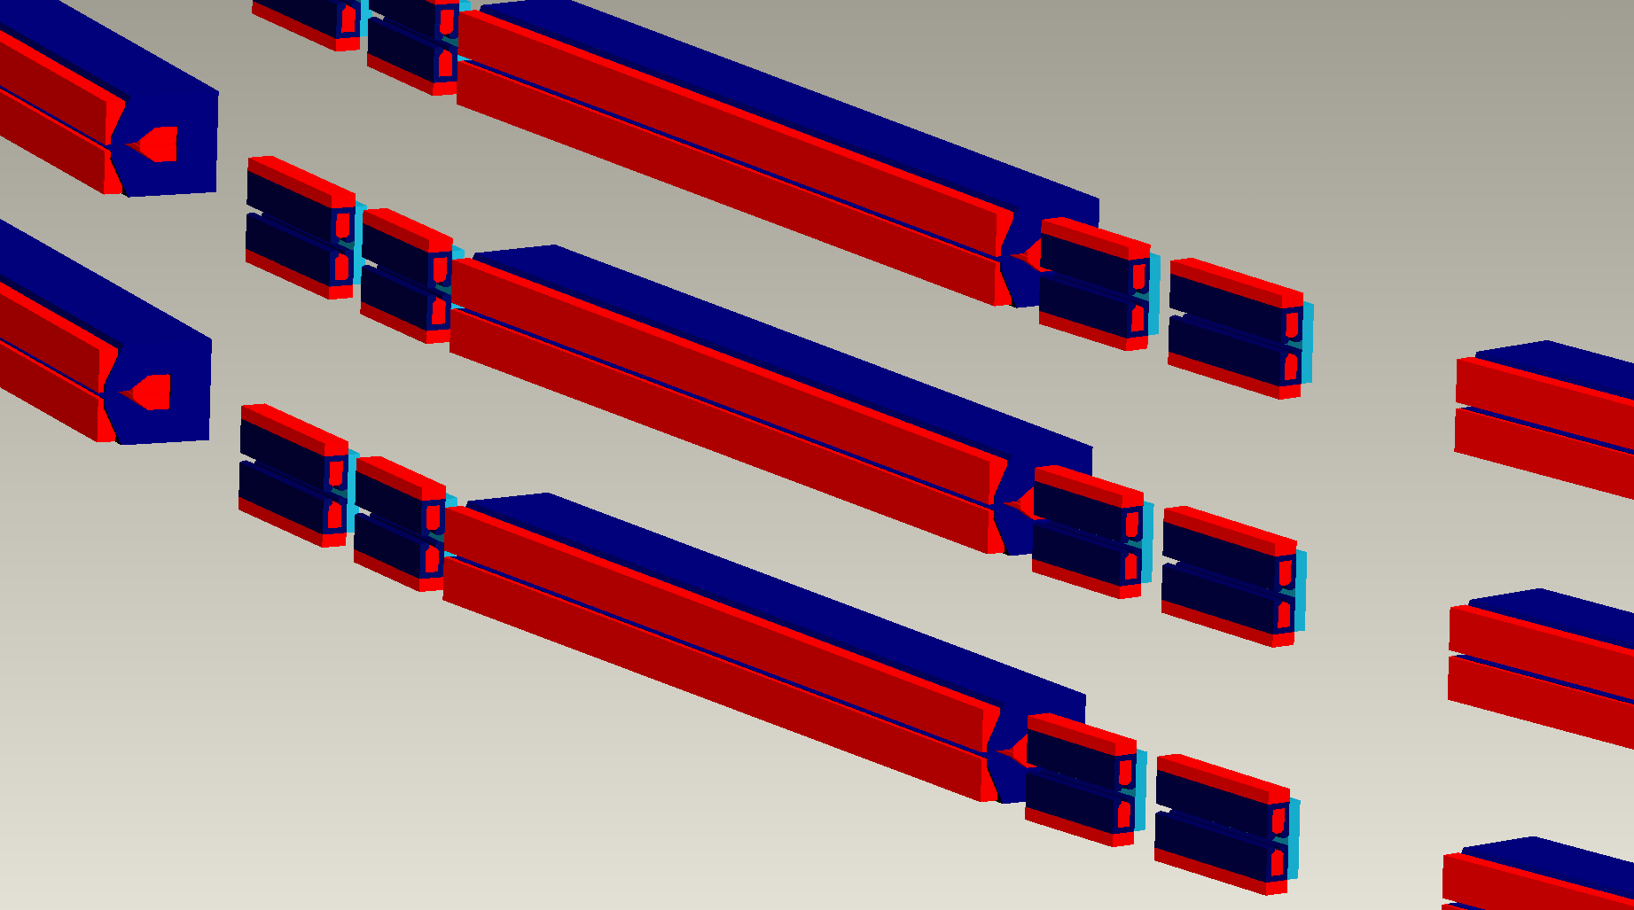
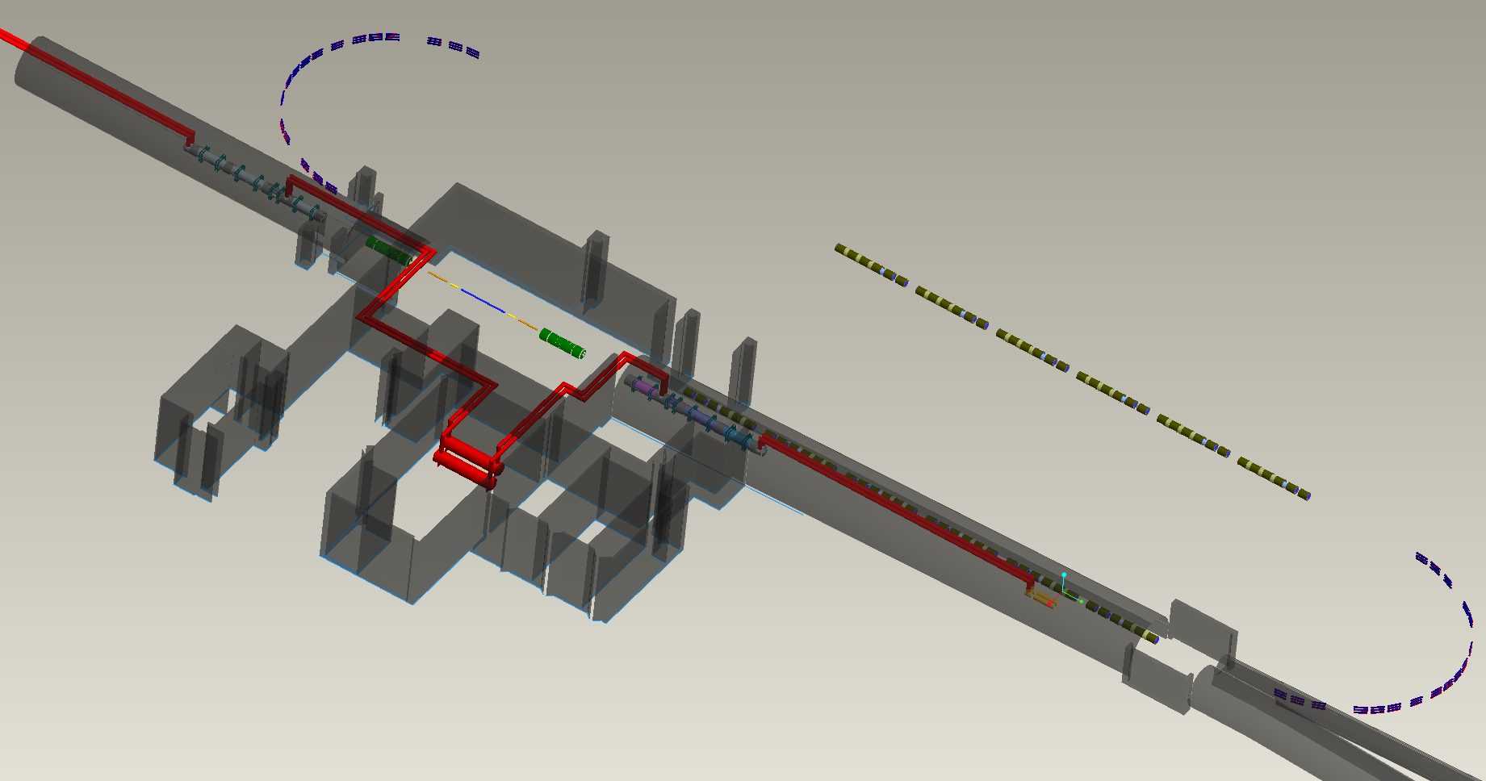
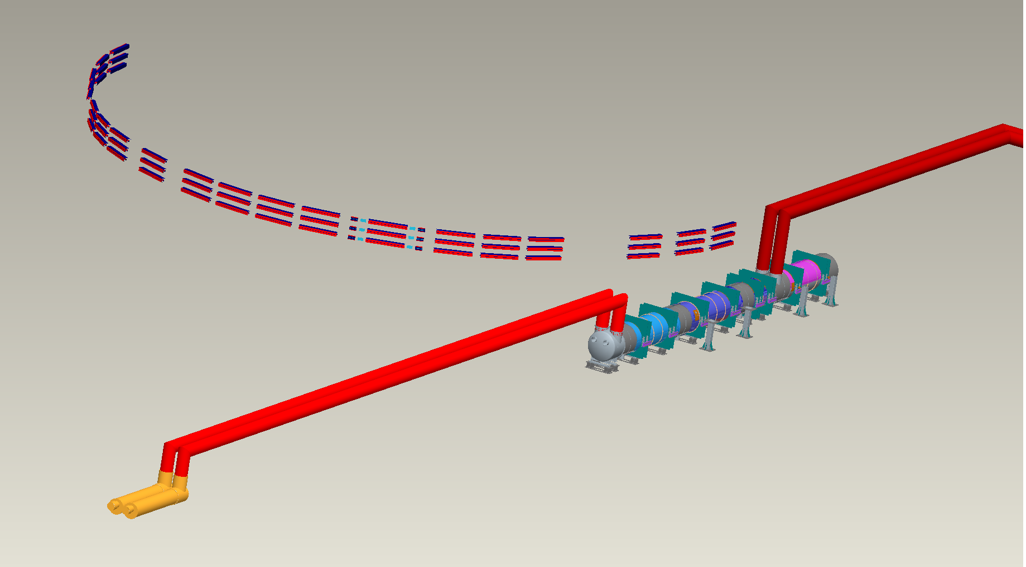
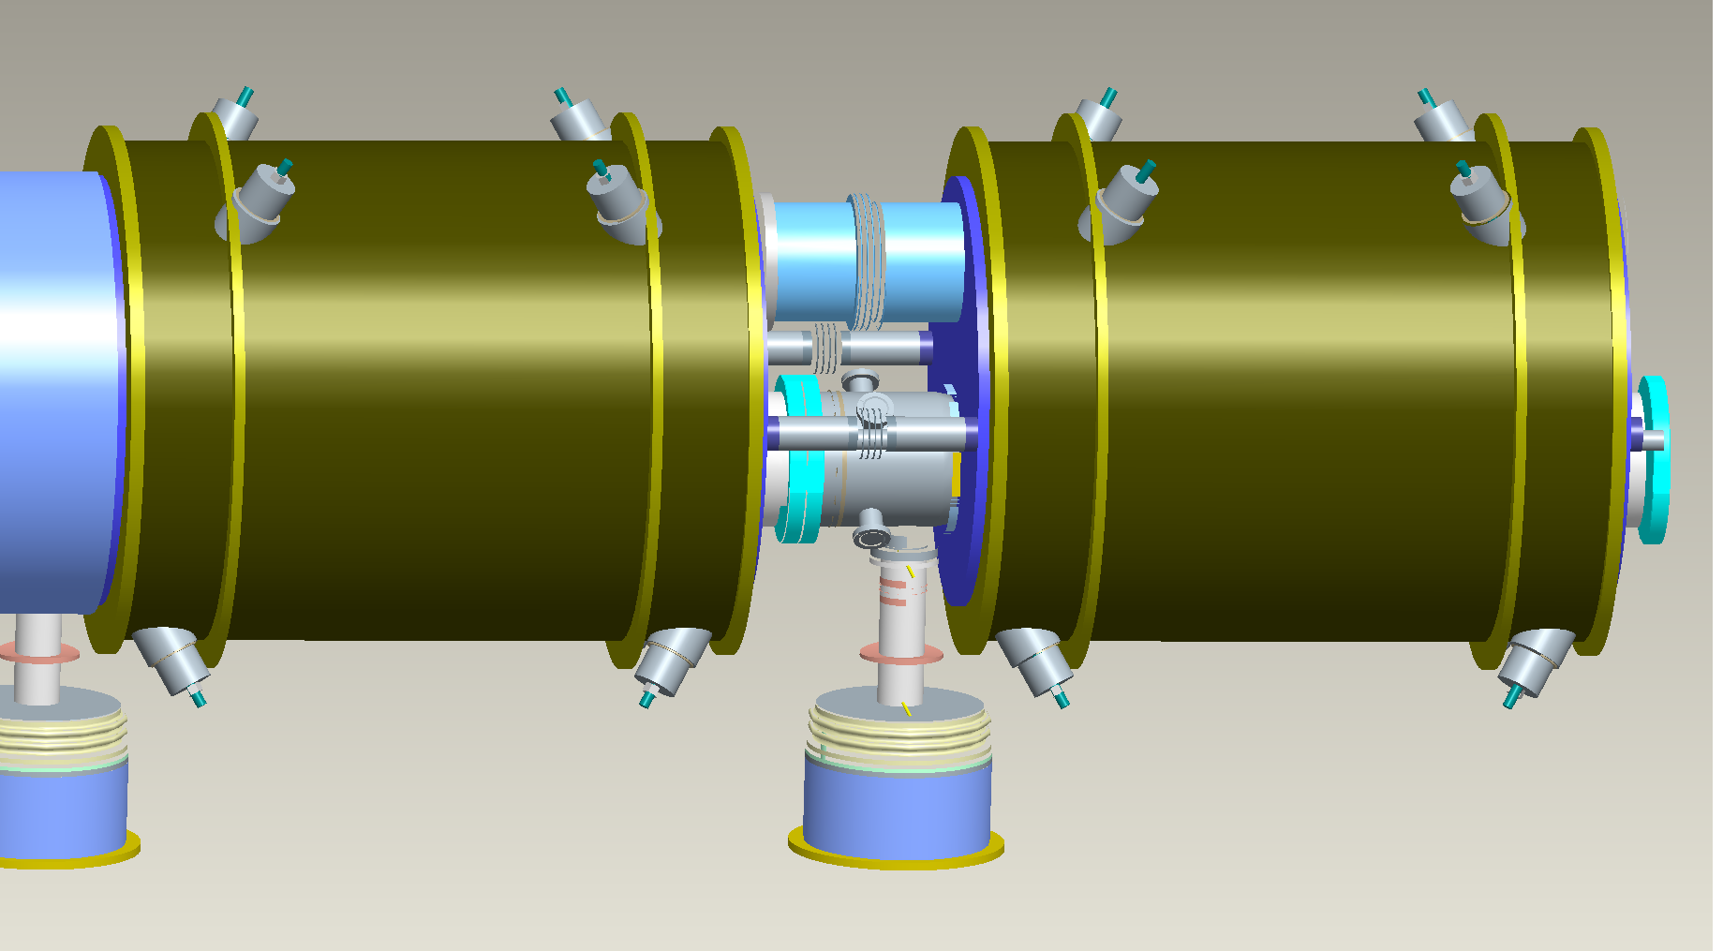
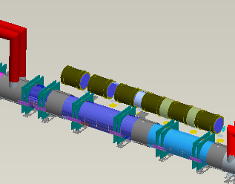
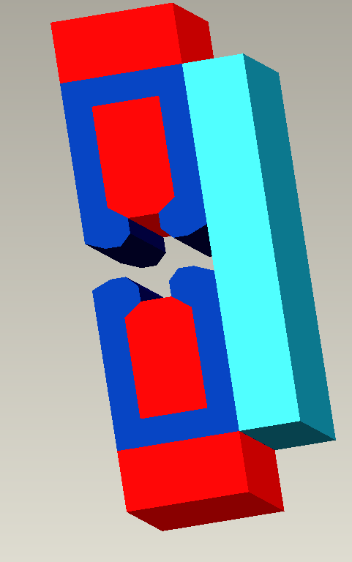
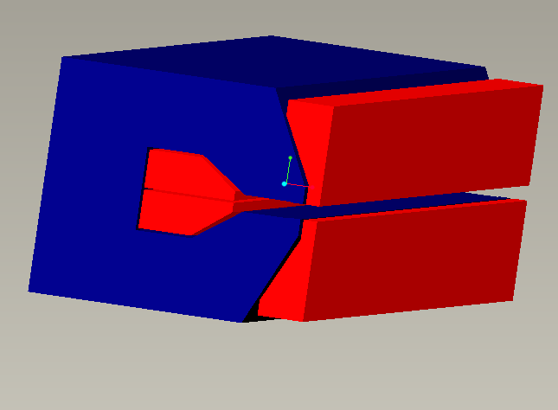
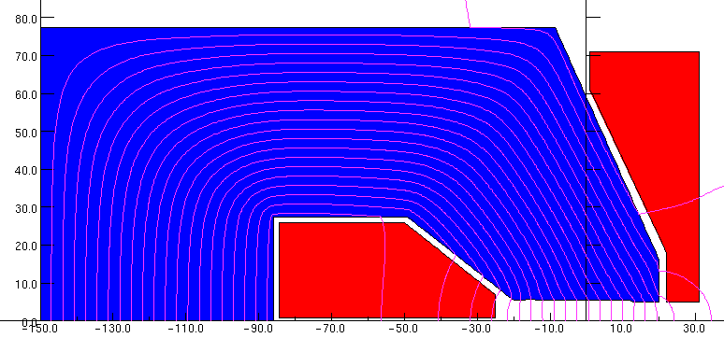
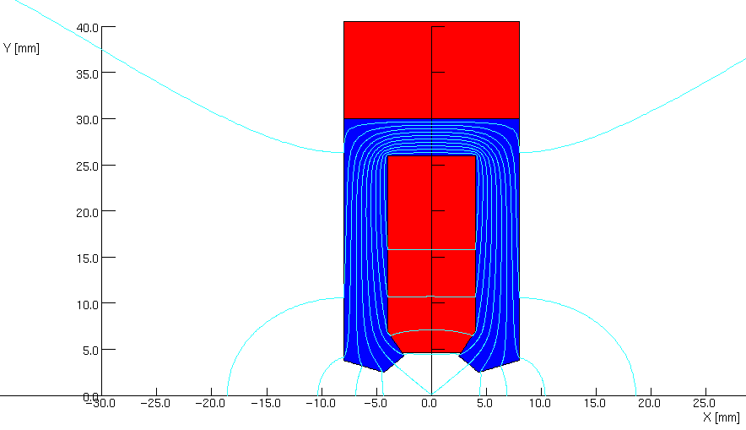
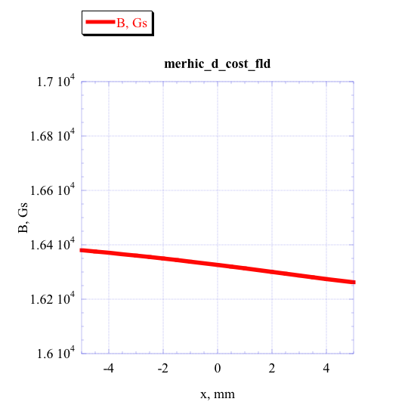
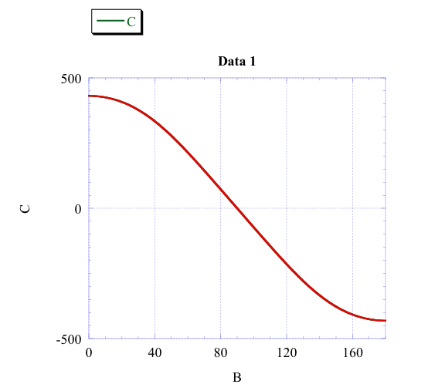
MeRHIC in IR 2: 3D layout
© J.C.Brutus, J. Tuozzolo, D. Trbojevic,
G. Mahler, B. Parker, W. Meng
V.N. Litvinenko, EINN 2009, Milos, Greece, September 27, 2009

Slide 33
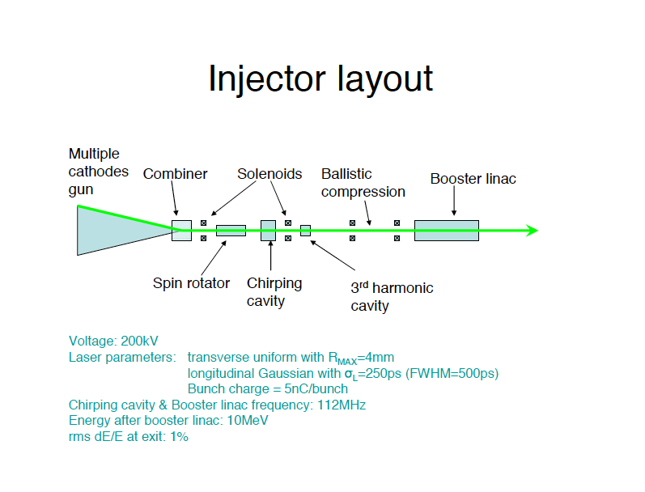
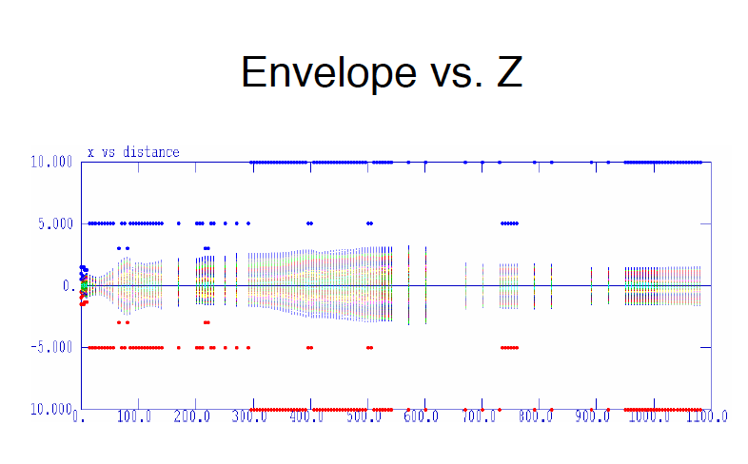
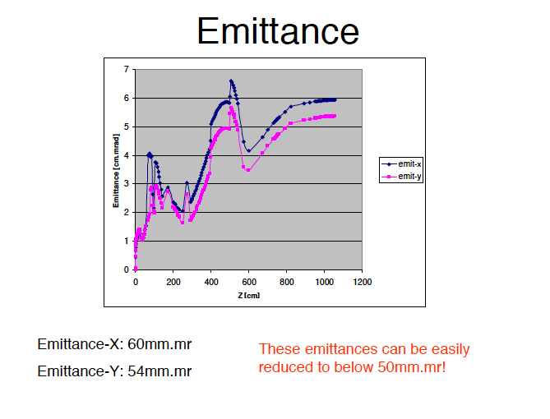


Polarized e-beam injector
VL
V.N. Litvinenko, EINN 2009, Milos, Greece, September 27, 2009

Slide 34

MeRHIC Linac Design
65m total linac length
All cold: no warm-to-cold transition
703.75 MHz
1.6 m long
Drift
1.5 m long
Based on BNL SRF cavity with fully suppressed HOMs
Critical for high current multi-pass ERL
100 MeV
4 GeV
100 MeV
I. Ben Zvi
Current breakdown of the linac
N cavities = 6 (per module)
N modules per linac = 6
N linacs = 2
L module = 9.6m
L period = 10.6 m
E_{f} = 18.0 MeV/m
⟨dE/ds⟩ = 10.2 MeV/m
E.Pozdeyev
V.N. Litvinenko, EINN 2009, Milos, Greece, September 27, 2009

Slide 35
SUB-ATMOSPHERIC SYSTEM
4.5K
PLANT
LN2
FPC INTERCEPT
SHIELD
4

Slide 36



Methods and solutions: asynchronous arcs
Goals:
-Have a good packing factor
- α_{c}=0 or M_{5,6}=0
- small dispersion
- small betatron functions
- reduce cost of civil construction
Dispersion function oscillates between ±1.8 m and the momentum compaction is adjustable:
Dejan Trbojevic: EPAC 1990, pp. 1536:
“Design Method for High energy Accelerators without Transition Energy.”
V.N. Litvinenko, EINN 2009, Milos, Greece, September 27, 2009

Slide 37
Switchyard at the linac
0.1GeV
0.16 m
1.4GeV
0.16 m
2.7GeV
0.702 m
0.136 m
4GeV
D4g3
0.2458 m
Q4g3
0.55 m
1.25 m
1.866 m
2.8423 m
V.N. Litvinenko, EINN 2009, Milos, Greece, September 27, 2009

Slide 38









Myriad of beam dynamics issues were studied for MeRHIC
No show-stoppers !
Majority of these findings were reported at MAC meeting in March 2009
Main finding – we could operate main SRF linacs without 3rd harmonics
V.N. Litvinenko, EINN 2009, Milos, Greece, September 27, 2009

Slide 39


In all cased the proper chromaticity suppresses kink instability
Nonlinear force model
with Hourglass effect
With rms proton
energy spread =1e-3
The optimum chromaticity is around ξ = +4
© Y. Hao
Recent studies proved our early assumption that using simple feed-back on electron beam suppress kink instability completely for all eRHIC parameter ranges
V.N. Litvinenko, EINN 2009, Milos, Greece, September 27, 2009
Notes:
39

Slide 40



TBBU stability (©E. Pozdeyev)
HOMs based on R. Calaga’s simulations/measurements
70 dipole HOM’s to 2.7 GHz in each cavity
Polarization either 0 or 90°
6 different random seeds
HOM Frequency spread 0-0.001
Simulated BBU threshold (GBBU) vs. HOM frequency spread.
Excitation process of transverse HOM
F (GHz) | R/Q (Ω) | Q | (R/Q)Q
0.8892 | 57.2 | 600 | 3.4e4
0.8916 | 57.2 | 750 | 4.3e4
1.7773 | 3.4 | 7084 | 2.4e4
1.7774 | 3.4 | 7167 | 2.4e4
1.7827 | 1.7 | 9899 | 1.7e4
1.7828 | 1.7 | 8967 | 1.5e4
1.7847 | 5.1 | 4200 | 2.1e4
1.7848 | 5.1 | 4200 | 2.1e4
eRHIC
Threshold significantly exceeds the beam current,
especially for the scaled gradient solution.
50 mA
V.N. Litvinenko, EINN 2009, Milos, Greece, September 27, 2009

Slide 41
eRHIC IR developments
eRHIC IR lattice is design in direct communication with EIC task-force and with inputs from EIC collaboration
Main boundary conditions on present IR designs – our main priority
  There should be no magnetic elements (except dipole magnets used for EIC physics!) of both electron and hadron accelerators
  One of the golden measurements (diffraction) required
    A) very strong dipole next to the IP
    B) very long element-free straight sections for excellent energy resolution
    C) no – zilch! - hard X-rays in the detector
  No – Zilch! – hard X-ray in the detector chamber
This limits choice of β* to 40 cm without CeC and to 25 cm with CeC. We found solutions to all existing demands. Focusing is not a problem in all this scenario and excellent fits are found for all cases (Tepikian for RHIC, Trbojevic of ERL).
Luminosity hungry experiments may require a dedicated IR, where accelerator elements are integrated into a detector (aka BarBar)
CeC can compress hadron bunch lengths to few cm and β* ~ 5 cm or even shorter are possible in such IR – few possible scenarios are under consideration. This IR can bring eRHIC luminosity well above 10³⁴.
V.N. Litvinenko, EINN 2009, Milos, Greece, September 27, 2009

Slide 42

Integrated IR design
MeRHIC 4 GeV e x 250 GeV p/100 GeV Au
Remove DXes – 40 m to detect particles scattered at small angles
1T, 3m
dipole
Soft
dipole
Soft
dipole
1T, 3m
dipole
e
p, Au
Solenoid, 4 T
40 m
To provide effective SR protection:
-soft bend (~0.05T) is used for final bending of electron beam
Solenoid (4T)
Dipole
~3Tm
© J.Bebee-Wang
© E. Aschenauer
V.N. Litvinenko, EINN 2009, Milos, Greece, September 27, 2009

Slide 43
eRHIC parameters
 | MeRHIC |  | eRHIC with CeC
 | p (A) | e | p (A) | e
Energy, GeV | 250 (100) | 4 | 325 (125) | 20 <30>
Number of bunches | 111 |  | 166
Bunch intensity (u) , 10¹¹ | 2.0 | 0.31 | 2.0 (3) | 0.24
Bunch charge, nC | 32 | 5 | 32 | 4
Beam current, mA | 320 | 50 | 420 | 50 <10>
Normalized emittance, 1e-6 m, 95% for p / rms for e | 15 | 73 | 1.2 | 25
Polarization, % | 70 | 80 | 70 | 80
rms bunch length, cm | 20 | 0.2 | 4.9 | 0.2
β*, cm | 50 | 50 | 25 (5) | 25 (5)
Luminosity, x 10³³, cm⁻²s⁻¹ | 0.1 -> 1 with CeC |  | 2.8 (14)
< Luminosity for 30 GeV e-beam operation will be at 20% level>
V.N. Litvinenko, EINN 2009, Milos, Greece, September 27, 2009

Slide 44
CODA
eRHIC II
eRHIC
MeRHIC
Luminosity reach for eRHIC is adjusted
to fit Jlab assumptions on achievable beam optics
V.N. Litvinenko, EINN 2009, Milos, Greece, September 27, 2009

Slide 45
Using Jlab assumptions would bring eRHIC luminosity to 1.4 x 10³⁵ cm⁻² sec⁻¹ micro-beta*, traveling RF focus, may be a crossing angle and crab-cavities
 | eRHIC with CeC
 | p (A) | e
Energy, GeV | 325 (125) | 20 <30>
Number of bunches | 166
Bunch intensity (u) , 10¹¹ | 2.0 (3) | 0.24
Bunch charge, nC | 32 | 4
Beam current, mA | 420 | 50 <10>
Normalized emittance, 1e-6 m, 95% for p / rms for e | 1.2 | 2.5
Polarization, % | 70 | 80
rms bunch length, cm | 4.9 | 0.2
β*, cm | 0.5 | 5
Luminosity, x 10³⁵, cm⁻²s⁻¹ | 1.4
Reducing β* by a factor of 50 boost luminosity by a factor of fifty
V.N. Litvinenko, EINN 2009, Milos, Greece, September 27, 2009

Slide 46
eRHIC’s assumptions are based on beam optics for HE hadron colliders such as RHIC, HERA, Tevatron, LHC
 | eRHIC with CeC
 | p (A) | e
Energy, GeV | 325 (125) | 20 <30>
Number of bunches | 166
Bunch intensity (u) , 10¹¹ | 2.0 (3) | 0.24
Bunch charge, nC | 32 | 4
Beam current, mA | 420 | 50 <10>
Normalized emittance, 1e-6 m, 95% for p / rms for e | 1.2 | 2.5
Polarization, % | 70 | 80
rms bunch length, cm | 4.9 | 0.2
β*, cm | 25 | 25
Luminosity, x 10³⁵, cm⁻²s⁻¹ | 0.028
We have reserves: increase intensities of electron and proton bunches about 2 fold, the rep-rate 2 fold and reduce beat* 5 fold – total up to 20 fold increase in luminosity.
V.N. Litvinenko, EINN 2009, Milos, Greece, September 27, 2009

Slide 47
eRHIC R&D
Polarized gun for e-p program
Development of compact recirculating loop magnets
R&D ERL
Compact eRHIC SRF with HOM damping
Coherent Electron Cooling including PoP
Polarized He³ source
Resources in FY 2009
Administrative - 1
Scientists (include. 2 PhD students) - 8
Professionals – 3
Technicians – 4
Total - 16
V.N. Litvinenko, EINN 2009, Milos, Greece, September 27, 2009

Slide 48
Challenges and Advantages
Main Challenge – 50 mA polarized gun for e-p program
Main advantage – RHIC
  Unique set of species from d to U
  The only high energy polarized proton collider
  Large size of RHIC tunnel (3.8 km)
Main limitation
  Ion cloud limits the hadron beam intensity
V.N. Litvinenko, EINN 2009, Milos, Greece, September 27, 2009

Slide 49



Main technical challenge is 50 mA
CW polarized gun: we are building it
3rd harmonic cavity
Single cathode DC gun
Solenoids
Spin rotator (Wien)
Cathodes
0.6m
Bunching optics
Booster linac (112MHz)
Combiner
0.7m
4m
0.5m
0.5m
DC gun
with 24 cathodes
Based on demonstrated
current technology developed at JLab
© X.Chang
© E.Tsentalovich, MIT
V.N. Litvinenko, EINN 2009, Milos, Greece, September 27, 2009

Slide 50



Coherent Electron Cooling (CeC)
At a half of plasma oscillation
Dispersion
E < E_{h}
Dispersion section
( for hadrons)
E_{h}
Hadrons
Modulator
E > E_{h}
Kicker
l₁
High gain FEL (for electrons)
l₂
Electrons
λ_{FEL}
Amplifier of the e-beam modulation in an FEL with gain G_{FEL}~10²-10³
v_{h}
Debay radii
E < E₀
λ_{FEL}
2 R_{D⊥}
E₀
2 R_{D//}
E > E₀
E_{z}
λ_{FEL}
Density
V.N. Litvinenko, EINN 2009, Milos, Greece, September 27, 2009

Slide 51
Possible layout for Coherent Electron Cooling
proof-of-principle experiment in RHIC IR
19.6 m
Kicker, 3 m
Modulator, 4 m
DX
DX
Wiggler 7m
Parameter
Species in RHIC | Au ions, 40 GeV/u
Electron energy | 21.8 MeV
Charge per bunch | 1 nC
Train | 5 bunches
Rep-rate | 78.3 kHz
e-beam current | 0.39 mA
e-beam power | 8.5 kW
Beam dump
20 MeV SRF linac
V.N. Litvinenko, EINN 2009, Milos, Greece, September 27, 2009

Slide 52



eRHIC loop magnets: LDRD project
Small gap provides for low current, low power consumption magnets
  -> low cost eRHIC
  Dipole prototype is under tests
  Quad and vacuum chamber are in advanced stage
Gap 5 mm total
0.3 T for 30 GeV
eRHIC
20 GeV
e-beam
16 GeV
e-beam
Common vacuum chamber
12 GeV
e-beam
8 GeV
e-beam
25 cm
5 mm
©, G. Mahler, W. Meng,
A. Jain, P. He, Y.Hao
V.N. Litvinenko, EINN 2009, Milos, Greece, September 27, 2009

Slide 53






R&D ERL
© I. Ben Zvi
V.N. Litvinenko, EINN 2009, Milos, Greece, September 27, 2009

Slide 54
Outlook
eRHIC designs provide for both polarized e-p and unpolarized eA collisions with high luminosity ~ 10³²-10³⁴cm⁻²sec⁻¹
  eRHIC choice of ERL for electron acceleration provides higher luminosity compared with ring-ring scenario
  eRHIC’s ERL has a natural staging strategy with increasing the energy of of the ERL is increasing length of linacs and the number of passes
  if physics justify the cost – RHIC could be upgraded to 800 GeV by replacing magnets in one of its rings with LHC-class
  MeRHIC technical design and cost estimate are progressing with plan to complete first release in Fall 2009
V.N. Litvinenko, EINN 2009, Milos, Greece, September 27, 2009

Slide 55

V.N. Litvinenko, EINN 2009, Milos, Greece, September 27, 2009

Slide 56
eRHIC targeted LDRD-proposals
Accelerator:
  Proof of principle for a gatling gun polarized electron source
  PI: Ilan Ben-Zvi
  laser development for polarized electron source
  PI: Treveni Rao
  undulator development for coherent electron cooling
  PI: Vladimir Litvinenko
  polarized ³He source development
  PI: Anatoli Zelenski
Physics / Detector:
  eA event generator development
  PI: Thomas Ullrich
  silicon sensor development for compact EM calorimetry
  PI: Eduard Kistenev
  Roman Pot development for eA/ep diffractive experiments
  PI: Wlodek Guryn
V.N. Litvinenko, EINN 2009, Milos, Greece, September 27, 2009

Slide 57
Back up

Slide 58














Slide 59




e-Beam Disruption
protons
e
Interaction
Optimized
©Y. Hao
V.N. Litvinenko, EINN 2009, Milos, Greece, September 27, 2009

Slide 60


IR without DXes: 5-fold flexibility for hadron energy
J. Beebe-Wang, E.-C. Aschenauer
Hard X-rays
2 W
Soft X-rays
Hard X-rays
40 cm β* and 40 m element free space
Integrated 5.8 m long 4 T solenoid
First indication that it is good layout for diffraction physics
There is enough flexibility in the layout to accommodate main detector needs
V.N. Litvinenko, EINN 2009, Milos, Greece, September 27, 2009

Slide 61

Spreader / Combiners
The left and right spreader / combiner sections are similar, differing only in that the section with the 100 MeV arc requires a split magnet to accommodate the lowest energy beam.
The dipole arrangement uses one common magnet path – either single or split, and three individual dipoles separate the beams of different energies.
The quadrupoles in this section are connected in groups to reduce cost.

Slide 62
SUB-ATMOSPHERIC SYSTEM
4.5K
plant
4.5K
plant
HYBRID COMPRESSION
1.8K 2400 W LHC –CERN
1.8K 5000 W BNL MeRHIC
100% COLD COMPRESSION
2K 4600 W Thomas Jefferson National Lab
2K 2400 W Spallation Neutron Source
4

Slide 63



RHIC lattice modification – Steven Tepikian
β∗=0.4 m
V.N. Litvinenko, EINN 2009, Milos, Greece, September 27, 2009

Slide 64


Bog-bone MeRHIC at 2 o’clock IR at RHIC (Dec. 2009)
2 recirculating passes:
1.39 and 2.70 GeV
Plus 4 GeV through the detector
3 recirculating passes
0.74, 2.05, 3.35 GeV
Arc <R>=9 m
Gun
Beam dump
Discontinued since April 2009
180º+45º arc,
<R> ~ 8 m
Lattice and IR by D.Trbojevic, D.Kayran
(April 09)
V.N. Litvinenko, EINN 2009, Milos, Greece, September 27, 2009

Slide 66

Methods and solutions: construction of the asynchronous arcs:

Slide 68
Asynchronous arcs: 3.35 GeV Betatron Functions
Dmitri Kayran, Dejan Trbojevic

Slide 69
RHIC lattice modification – Steven Tepikian
β∗~0.5 m

Slide 70


Slide 71

Zero dispersion IP and detector protected Interaction Region
C. Montag, B. Parker, J. Beebe-Wang, D. Kayran and D. Trbojevic

Slide 72
ELIC
Dear Vladimir
thanks for your email and your kindly offer for presenting our
ELIC design in your invited talk at the upcoming EINN Workshop.
Unfortunately, we are not able to provide slides as you requested
in a such short notice. Both of us are very busy at the moment.
We may also suggest you not using our old slides for your talk since
the ELIC design has being updated lately and quite significantly.
Your can present eRHIC along at this meeting. That is fine with us.
We appreciate your effort trying to include ELIC in your talk.
Best regards and have a nice trip.
Slava and Yuhong
Hi Vladimir,
I forwarded your request to Yuhong andSlava.
I'm hoping that they'll get you what you need.
Geoff
Courtesy of G. Krafft

Slide 73

V.N. Litvinenko, EINN 2009, Milos, Greece, September 27, 2009

Slide 74



IR with DXes and Vertical SB
V.N. Litvinenko, EINN 2009, Milos, Greece, September 27, 2009

Slide 75




IR layout with HB
V.N. Litvinenko, EINN 2009, Milos, Greece, September 27, 2009

Slide 76


Gains from coherent e-cooling:
Coherent Electron Cooling vs. IBS
IBS in RHIC for
eRHIC, 250 GeV, N_{p}=2.10¹¹
Beta-cool, ©A.Fedotov
Dynamics:
Takes 12 mins
to reach
stationary
point
This allows
keep the luminosity as it is
reduce polarized beam current down to 25 mA (5 mA for e-I)
increase electron beam energy to 20 GeV (30 GeV for e-I)
increase luminosity by reducing β* from 25 cm down to 5 cm
V.N. Litvinenko, EINN 2009, Milos, Greece, September 27, 2009

Slide 77
ERL spin transparency at all energies
Bargman, Mitchel,Telegdi equation
n passes
Total angle
Has solution
for all
energies!
n=2
Gun
V.N. Litvinenko, EINN 2009, Milos, Greece, September 27, 2009

Slide 78
MeRHIC parameters for e-p collisions
© V.Ptitsyn
 | not cooled |  | With cooling
 | p | e | p | e
Energy, GeV | 250 | 4 | 250 | 4
Number of bunches | 111 |  | 111
Bunch intensity, 10¹¹ | 2.0 | 0.31 | 2.0 | 0.31
Bunch charge/current, nC/mA | 32/320 | 5/50 | 32/320 | 5/50
Normalized emittance, 1e-6 m, 95% for p / rms for e | 15 | 73 | 1.5 | 7.3
rms emittance, nm | 9.4 | 9.4 | 0.94 | 0.94
beta*, cm | 50 | 50 | 50 | 50
rms bunch length, cm | 20 | 0.2 | 5 | 0.2
beam-beam for p /disruption for e | 1.5e-3 | 3.1 | 0.015 | 7.7
Peak Luminosity, 1e32, cm⁻²s⁻¹ | 0.93 |  | 9.3
Luminosity for light and heavy ions
is the same as for e-p if measured per nucleon!
V.N. Litvinenko, EINN 2009, Milos, Greece, September 27, 2009

Slide 79

Vertical splitters –
3.35 GeV, 2.05 GeV, and 0.75 GeV
© Nicholaus Tsoupas
V.N. Litvinenko, EINN 2009, Milos, Greece, September 27, 2009

Slide 80
V.N. Litvinenko, EINN 2009, Milos, Greece, September 27, 2009

Slide 81
V.N. Litvinenko, EINN 2009, Milos, Greece, September 27, 2009

Slide 82

Cathode holding and cooling tube
Bellows for rotation (BR)
Bellows for translation (BTR)
V.N. Litvinenko, EINN 2009, Milos, Greece, September 27, 2009

Slide 83

HV feedthrough
Caesiation x 6
Laser
Laser mirrors
Electron Beams
Laser windows
V.N. Litvinenko, EINN 2009, Milos, Greece, September 27, 2009

Slide 84

Cathode plate
Anodes (wall)
Solenoids
V.N. Litvinenko, EINN 2009, Milos, Greece, September 27, 2009

Slide 85
Conceptual design
for 4 GeV electrons
R = 13.343 m
Detector Solenoid
1 T, 3 m
1 T, 3 m
For protons 0.00359 rad
V.N. Litvinenko, EINN 2009, Milos, Greece, September 27, 2009

Slide 86

Lattice constraints:
Passes during acceleration or energy recovery between the two linacs should be asynchronous ( M₅₆=0 ), have smaller dispersion due to large δp/p (x_{δp}=D δp/p), dipole and the quadrupole magnetic fields should be ~1.5-1.8 T, with zero dispersion through linacs and at the interaction point, reduce-remove the synchrotron radiation through detector, vertical beam splitting, use the present detector layout.
V.N. Litvinenko, EINN 2009, Milos, Greece, September 27, 2009

Slide 87
Methods and solutions: construction of the asynchronous arcs:
V.N. Litvinenko, EINN 2009, Milos, Greece, September 27, 2009

Slide 88


Slide from:

Slide 89
2008: Staging of eRHIC
MeRHIC: Medium Energy eRHIC
  Both Accelerator and Detector are located at IP2 of RHIC
  4 GeV e⁻ x 250 GeV p (45 or 63 GeV c.m.), L ~ 10³²-10³³ cm⁻² sec ⁻¹
  90% of hardware will be used for HE eRHIC
eRHIC, High energy and luminosity phase, inside RHIC tunnel
Full energy, nominal luminosity
  Polarized 20 GeV e⁻ x 325 GeV p (160 GeV c.m), L ~ 10³³-10³⁴ cm⁻² sec ⁻¹
  30 GeV e x 120 GeV/n Au (120 GeV c.m.), ~1/5 of full luminosity
  and 20 GeV e x 120 GeV/n Au (120 GeV c.m.), full liminosity
eRHIC up-grades – if needed, inside RHIC tunnel
Higher luminosity at reduced energy
    Polarized 10 GeV e⁻ x 325 GeV p, L ~ 10³⁵ cm⁻² sec ⁻¹
  Or Higher energy operation with one new 800 GeV RHIC ring
    Polarized 20 GeV e⁻ x 800 GeV p (~300 GeV c.m), L ~ 10³⁴ cm⁻² sec ⁻¹
    30 GeV e x 300 GeV/n Au (~200 GeV c.m.), L ~ 10³² cm⁻² sec ⁻¹
V.N. Litvinenko, EINN 2009, Milos, Greece, September 27, 2009

Slide 90
eRHIC parameters
 | MeRHIC |  | eRHIC with CeC |  | eRHIC II 8T RHIC
 | p (A) | e | p (A) | e | p/A | e
Energy, GeV | 250 (100) | 4 | 325 (125) | 20 <30> | 800 (300) | 20 <30>
Number of bunches | 111 |  | 166 |  | 166
Bunch intensity (u) , 10¹¹ | 2.0 | 0.31 | 2.0 (3) | 0.24 | 2.0 (3) | 0.24
Bunch charge, nC | 32 | 5 | 32 | 4 | 32 | 4
Beam current, mA | 320 | 50 | 420 | 50 <5> | 420 | 50 <10>
Normalized emittance, 1e-6 m, 95% for p / rms for e | 15 | 73 | 1.2 | 18 | 1 | 10
Polarization, % | 70 | 80 | 70 | 80 | 70 (?) | 80
rms bunch length, cm | 20 | 0.2 | 4.9 | 0.2 | 4.5 | 0.2
β*, cm | 50 | 50 | 25 (5) | 25 (5) | 25 (5) | 25 (5)
Luminosity, x 10³³, cm⁻²s⁻¹ | 0.1 -> 1 with CeC |  | 2.8 (14) |  | 6 (30)
< Luminosity for 30 GeV e-beam operation will be at 20% level>
V.N. Litvinenko, EINN 2009, Milos, Greece, September 27, 2009

Slide 91
eRHIC timeline
BNL & MIT
Add 10 GeV electron machine to RHIC with 250 GeV polarized protons and 100 GeV/n ions
Luminosity is based on hadron beam parameters demonstrated in RHIC complex
First paper and workshop on eRHIC – 1999
“eRHIC Zeroth-Order Design Report” and cost estimate, BNL 2004
  Ring-ring (e-ring designed by MIT) was the main option, L~10³²
  70+ page appendix on Linac (ERL) – Ring as back-up, L~10³³
2007 – after detailed studies we found that linac-ring has 5-10 fold higher luminosity – it became the main option
  Our understanding of the luminosity gains coming from linac-ring improved and now we understand that for part of EIC physics luminosity L>10³⁴ can be achieved
eA group made a case that 20 (or even 30 GeV) electrons are needed
March 2008 – first staging option of eRHIC of all-in-the tunnel ERL with 2(4) GeV as the first stage, with 10 GeV and 20 GeV as next steps
  there is potential for increase of RHIC energy to 800 GeV if physics justifies the cost
2009 – we work on MeRHIC (Medium energy eRHIC) design, layout and the cost estimate including the pass to full energy eRHIC, with a plan to have first release of Design Report in the Fall
V.N. Litvinenko, EINN 2009, Milos, Greece, September 27, 2009

